Slide 1
Crack case

Slide 2


This is Sophia.

Slide 3

And this is Bobby.

Slide 4
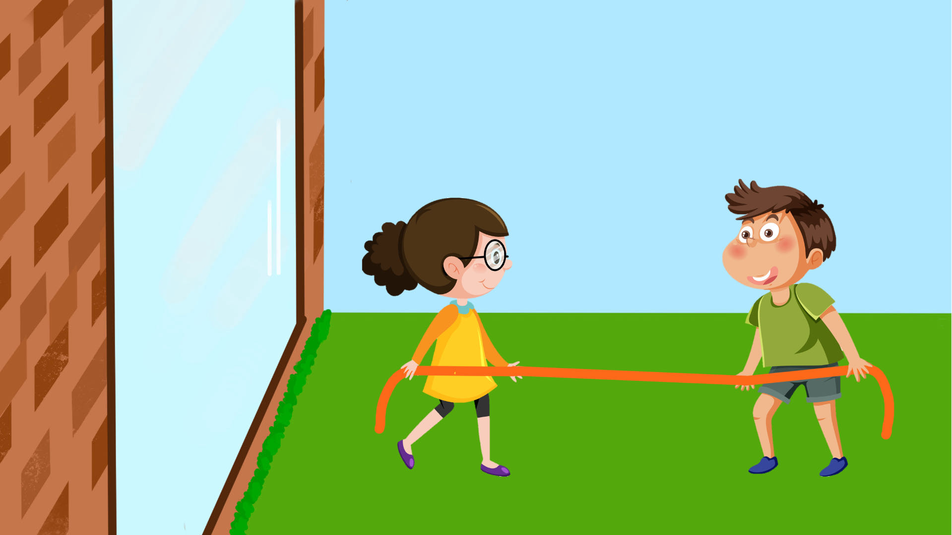
Sophia and Bobby are playing tug of war in the yard outside their house.

Slide 5
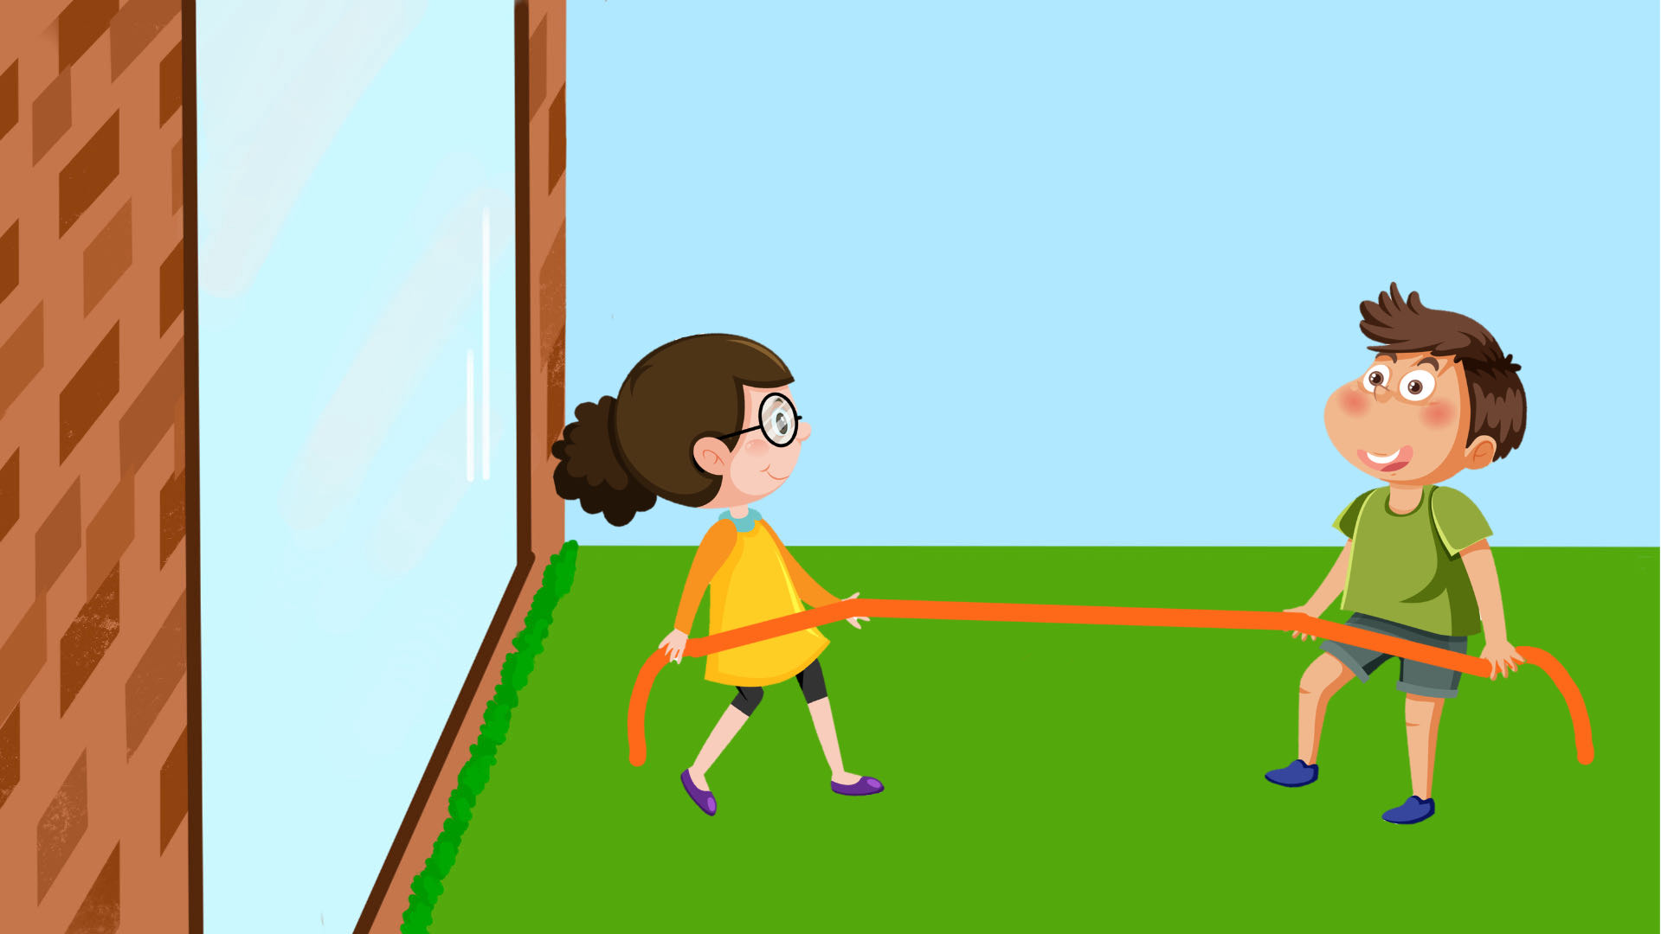
Both of them are pulling really hard on the rope.

Slide 6
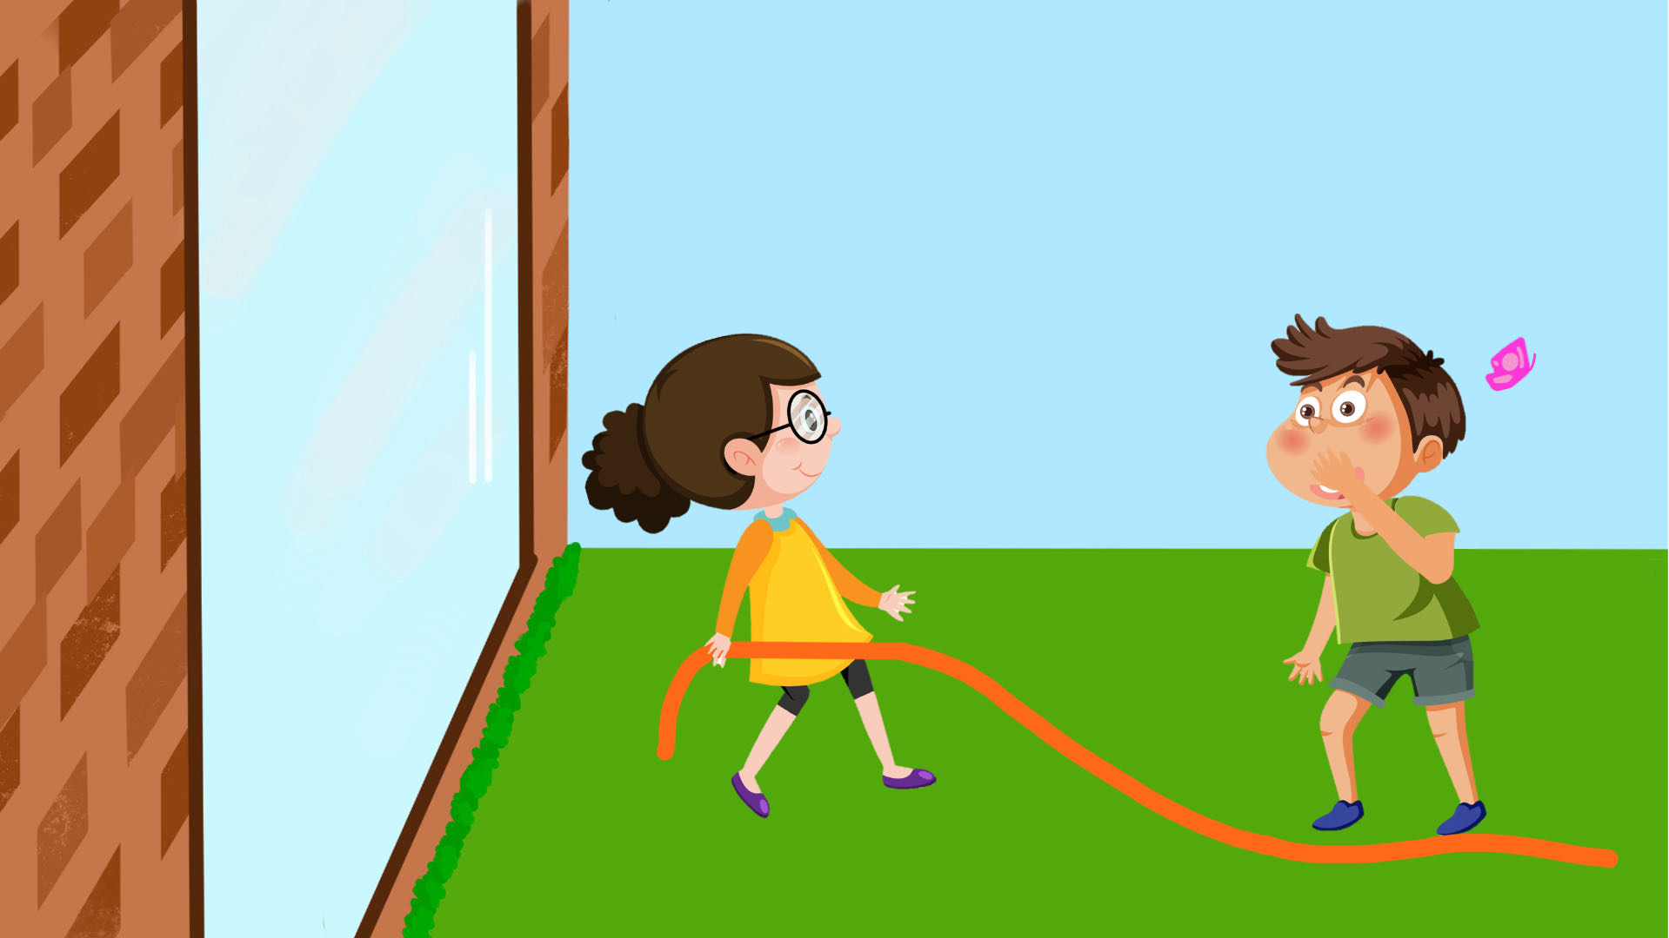

While Sophia is pulling, Bobby suddenly lets go of the rope!

Slide 7
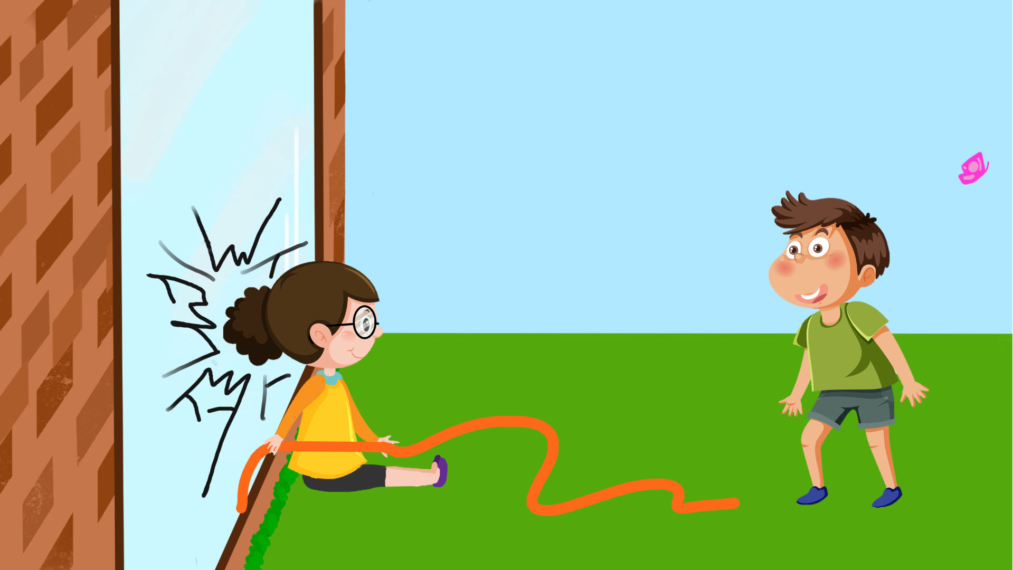
Sophia falls into the window, and it cracks.

Slide 8
Luckily, nobody got hurt – Sophia was OK.

Slide 9
Now that you saw what happened we would like to ask you a couple of questions.

Slide 10
Who cracked the window?

Slide 11
Who caused the window to crack?

Slide 12
Whose fault is it that the window cracked?

Slide 13
Break case

Slide 14

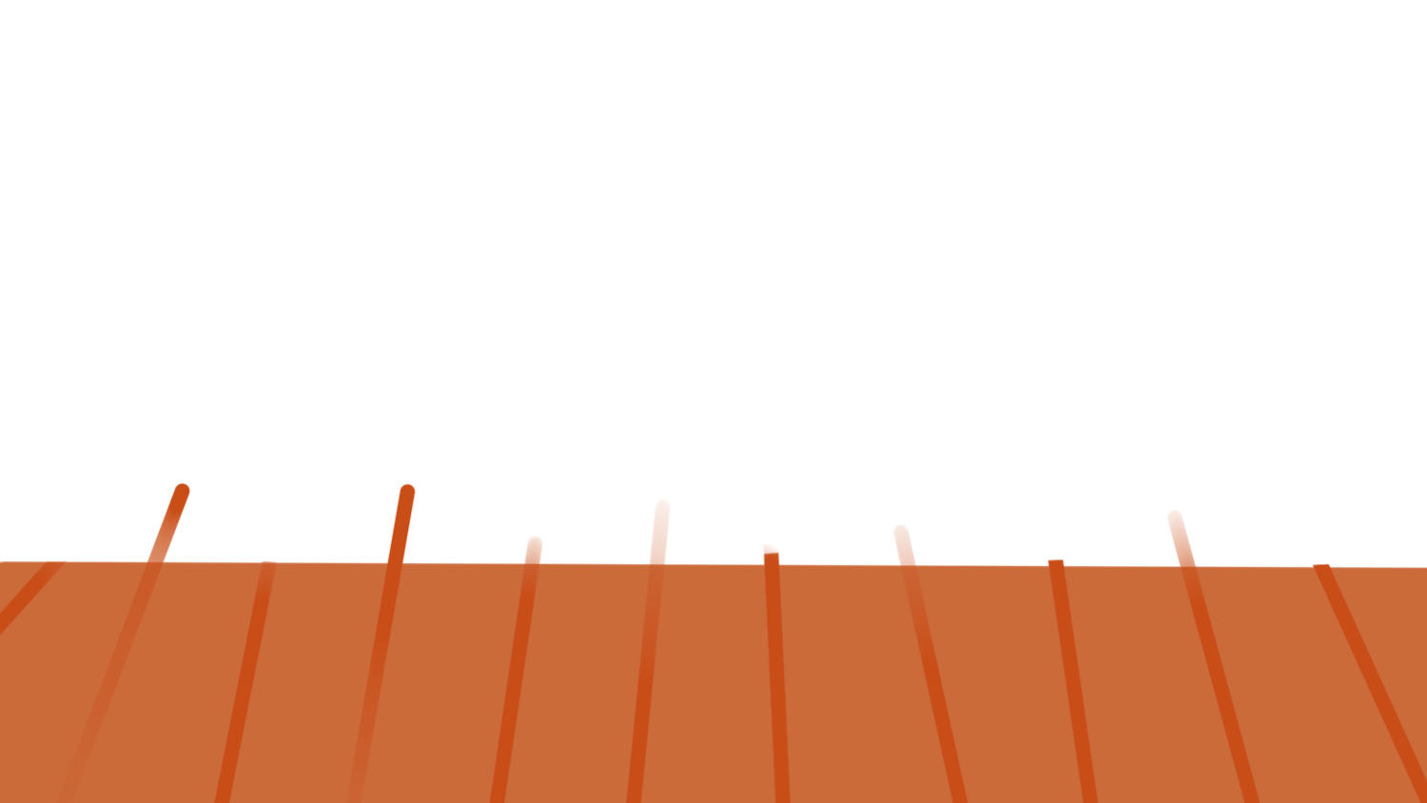

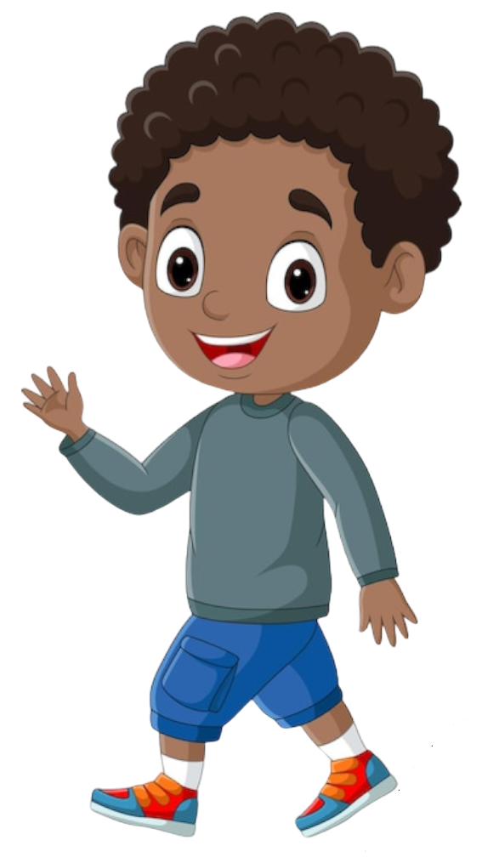
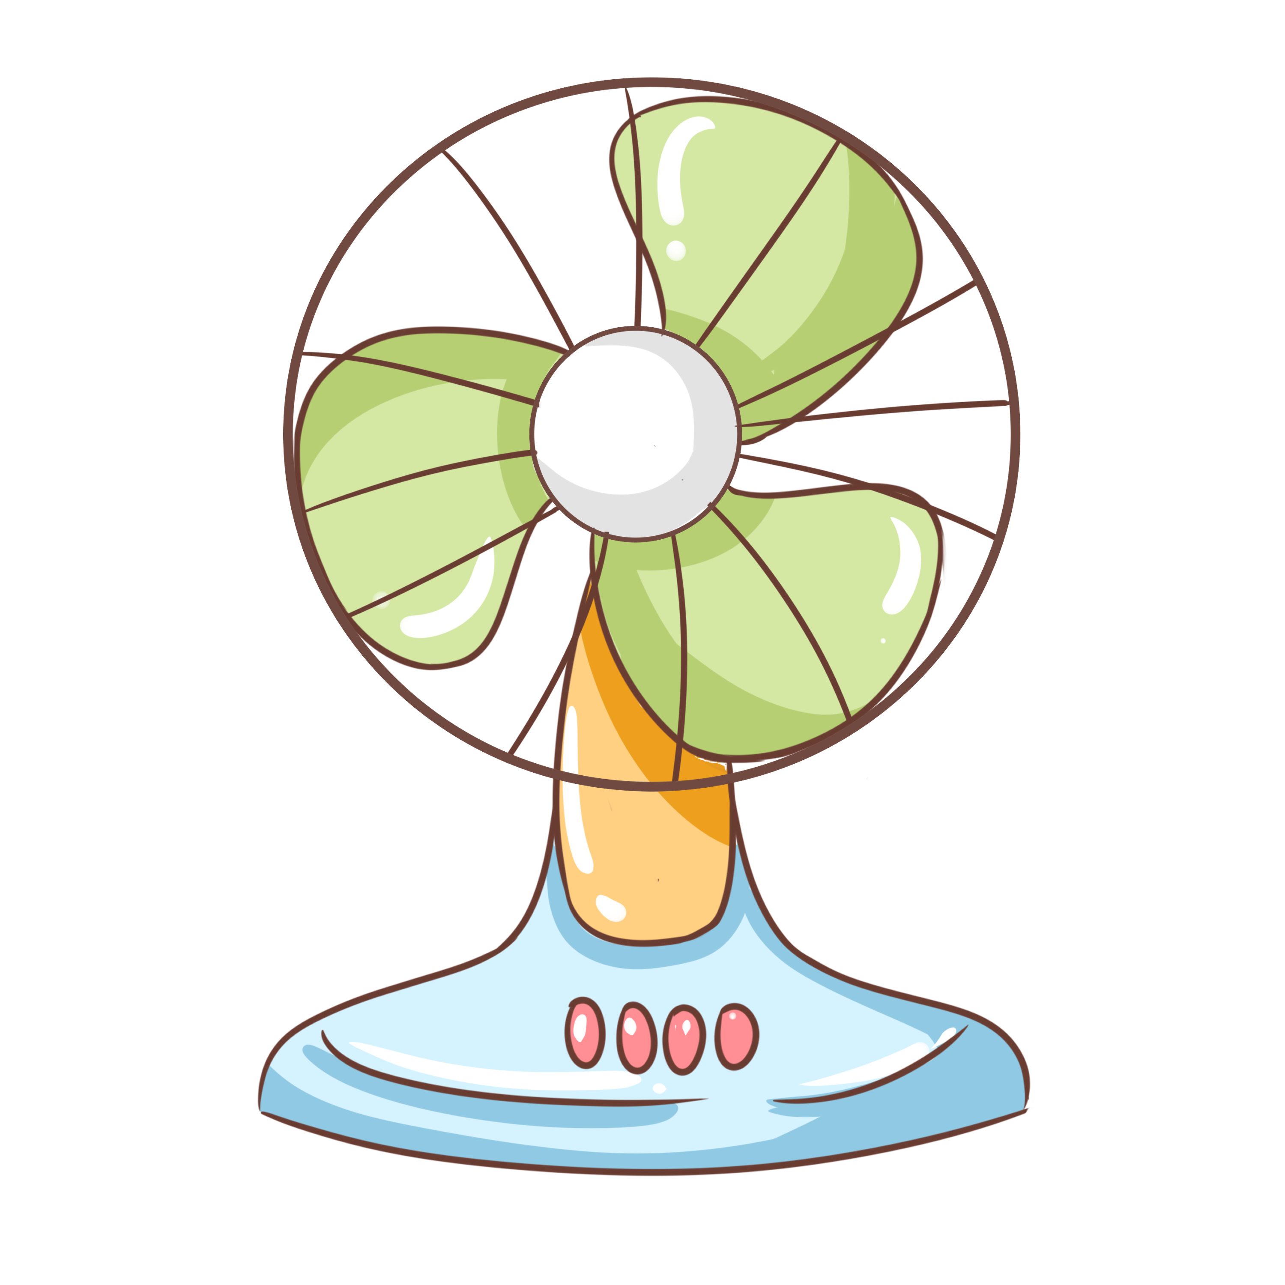
This is Suzy.

Slide 15
And this is Andy.

Slide 16
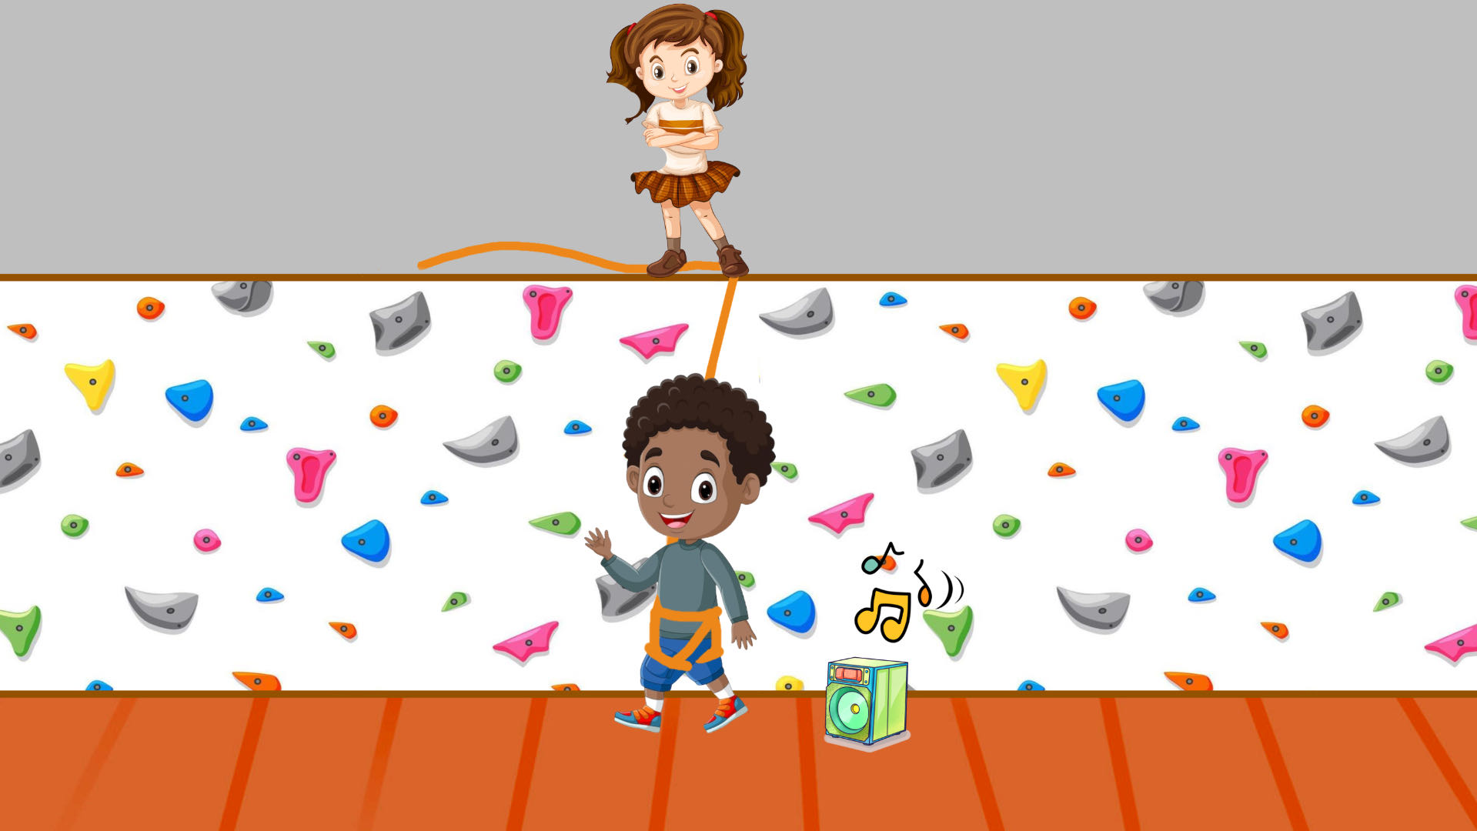
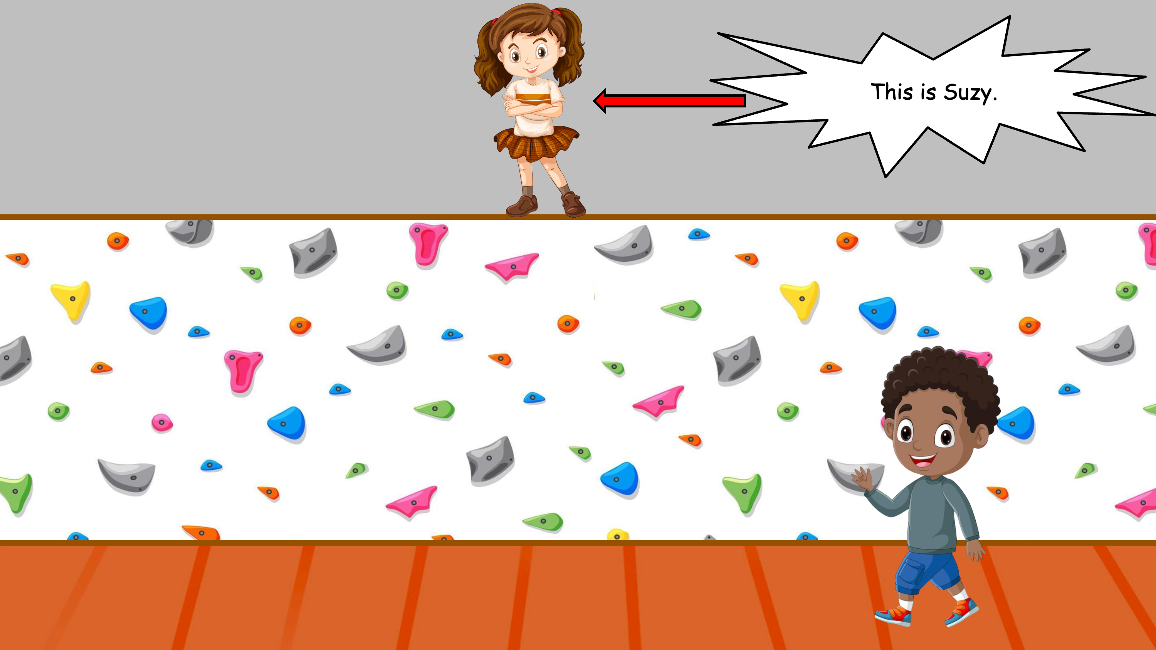
Suzy stands on Andy’s rope to prevent Andy from falling.

Slide 17
See? Suzy is standing on Andy’s rope.

Slide 18
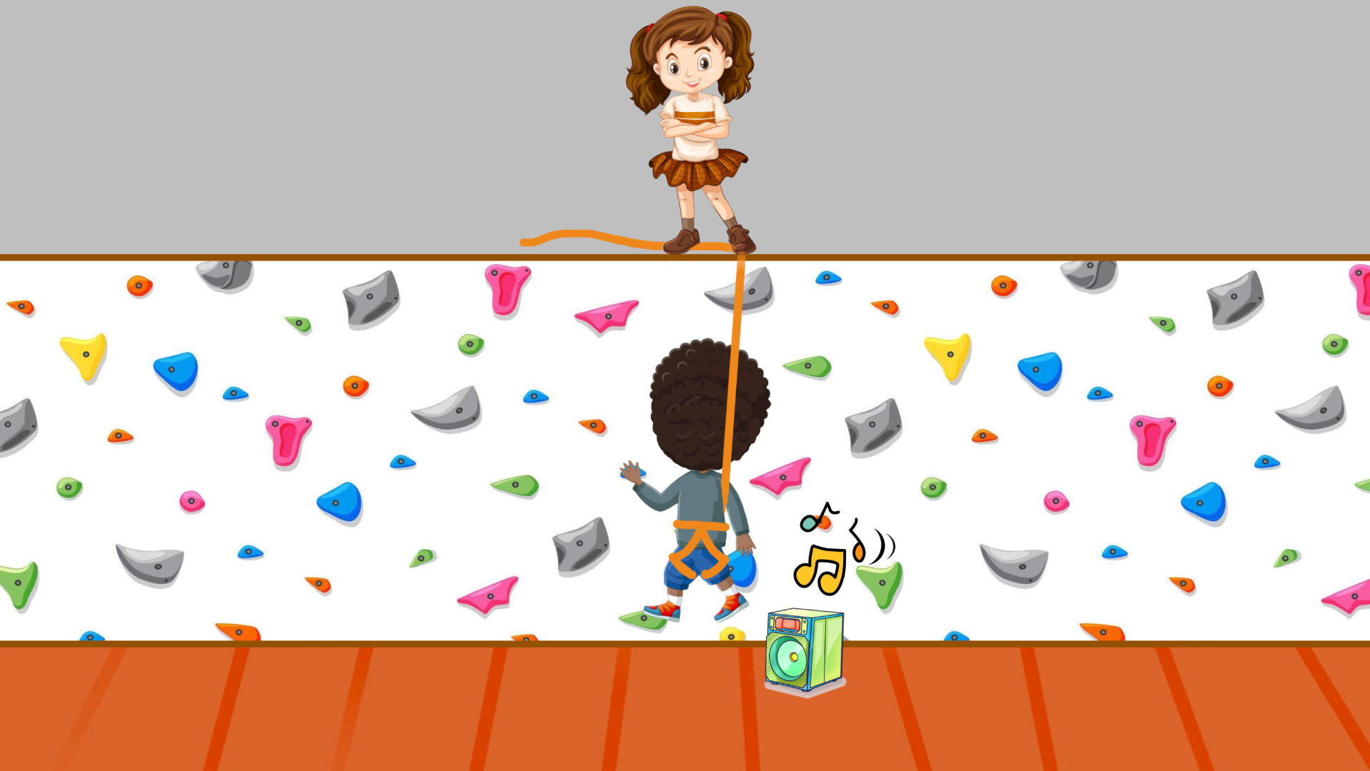
Andy starts climbing up the wall.

Slide 19
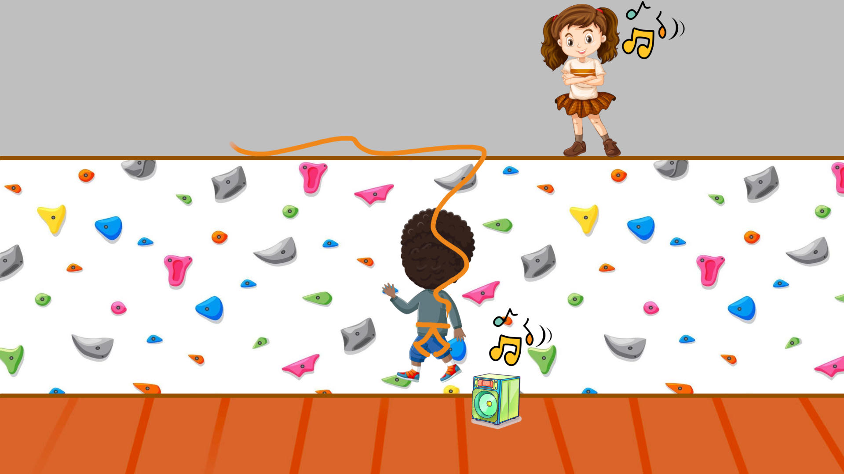

As Andy is climbing, Suzy wanders off.

Slide 20
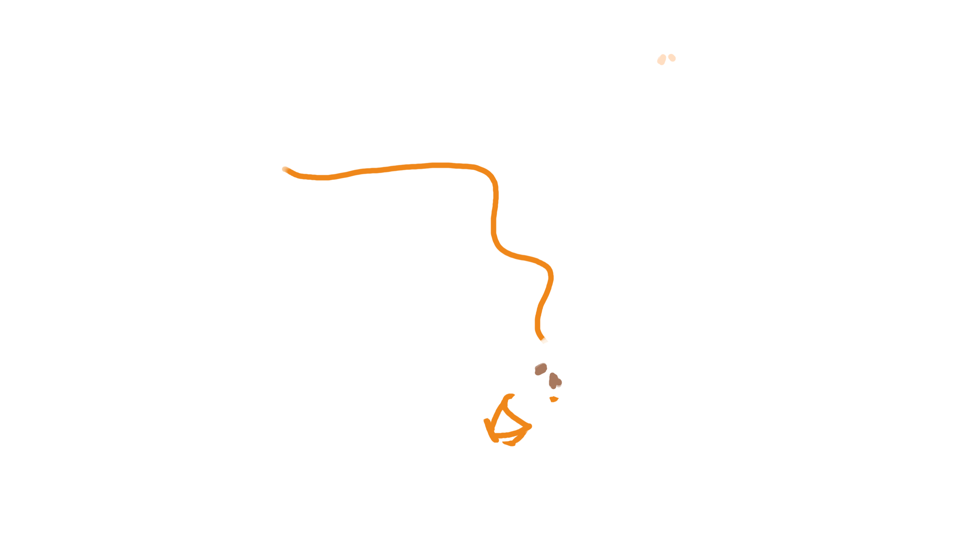
Andy loses grip of the rock and falls.

Slide 21
Oh no Suzy isn’t holding Andy’s rope!

Slide 22
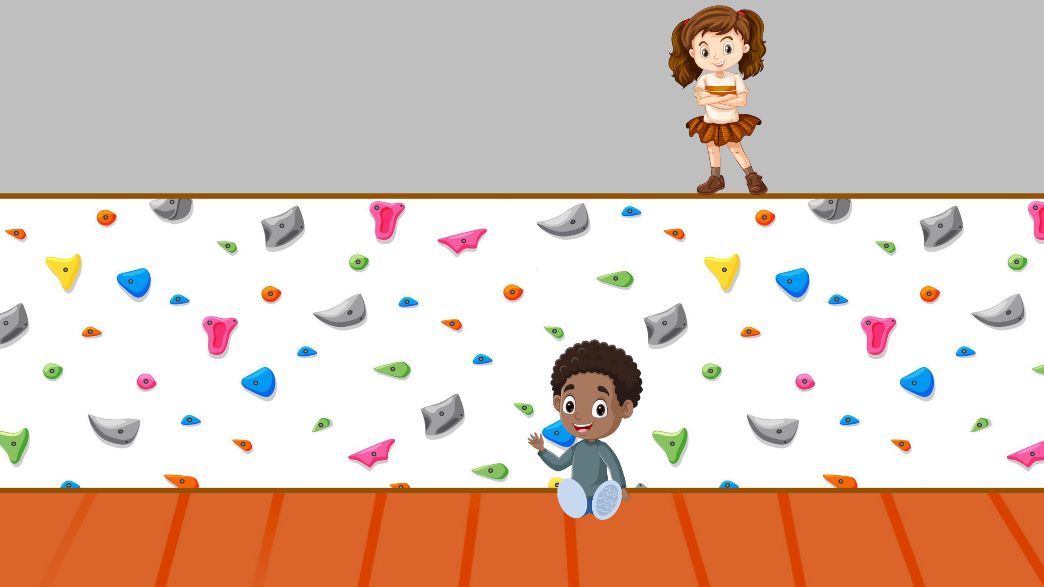
!!
Andy falls on the fan and it breaks.

Slide 23
Luckily, nobody got hurt – Andy was OK.
!!

Slide 24
Now that you saw what happened we would like to ask you a couple of questions.
!!

Slide 25
Who broke the fan?
!!

Slide 26
Who caused the fan to break?
!!

Slide 27
Whose fault is it that the fan broke?
!!

